Slide 1
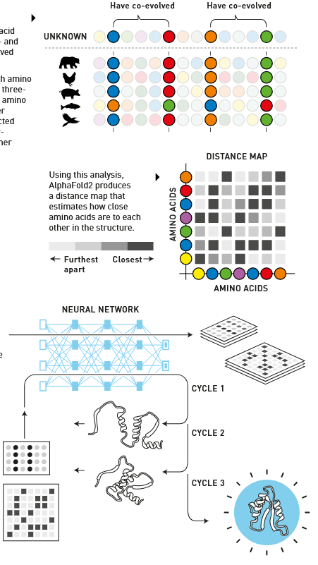
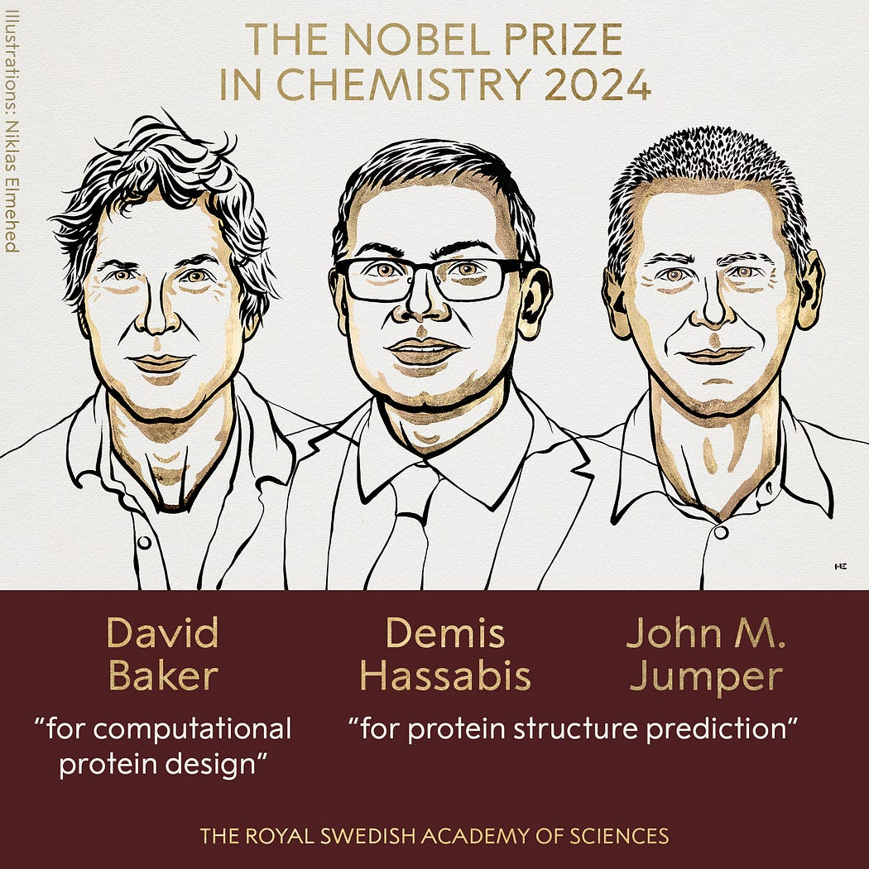
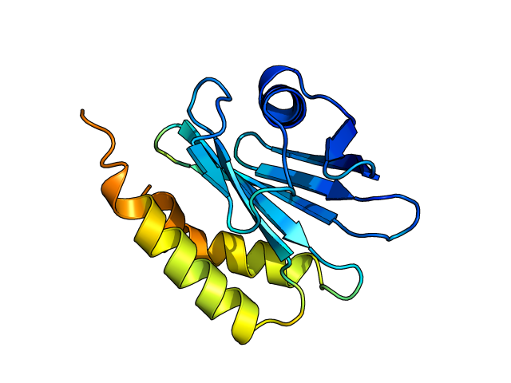

Dr Keiran Rowell – The Florey Institute of Neuroscience and Mental Health - 13 November 2025
Easy protein structure prediction with ProteinFold AI/Deep Learning for biomedical research
unsw.edu.au/research/facilities-and-infrastructure/find-a-facility/sbf

Slide 2


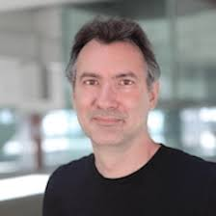

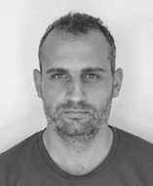

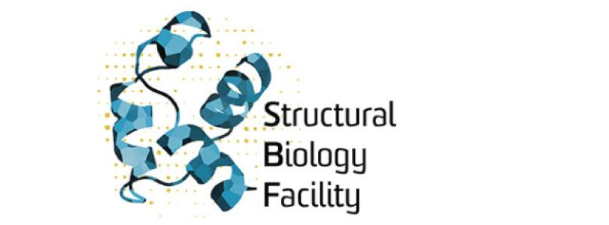
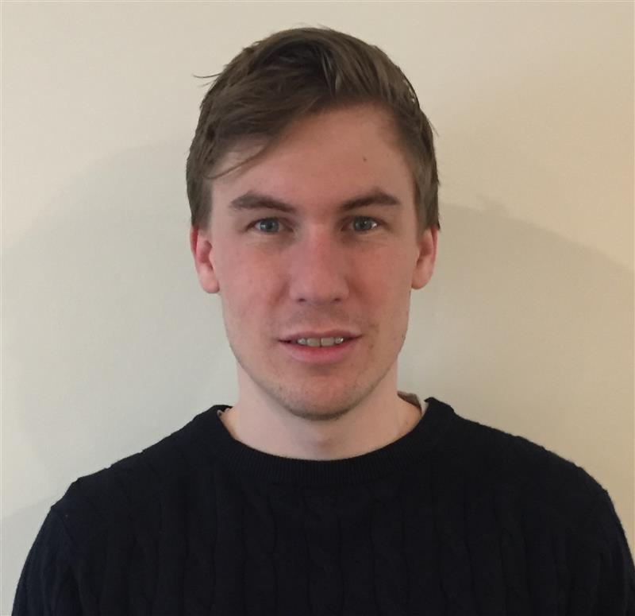
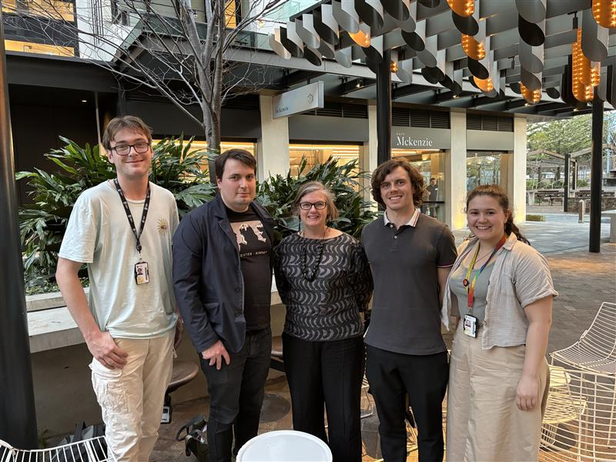
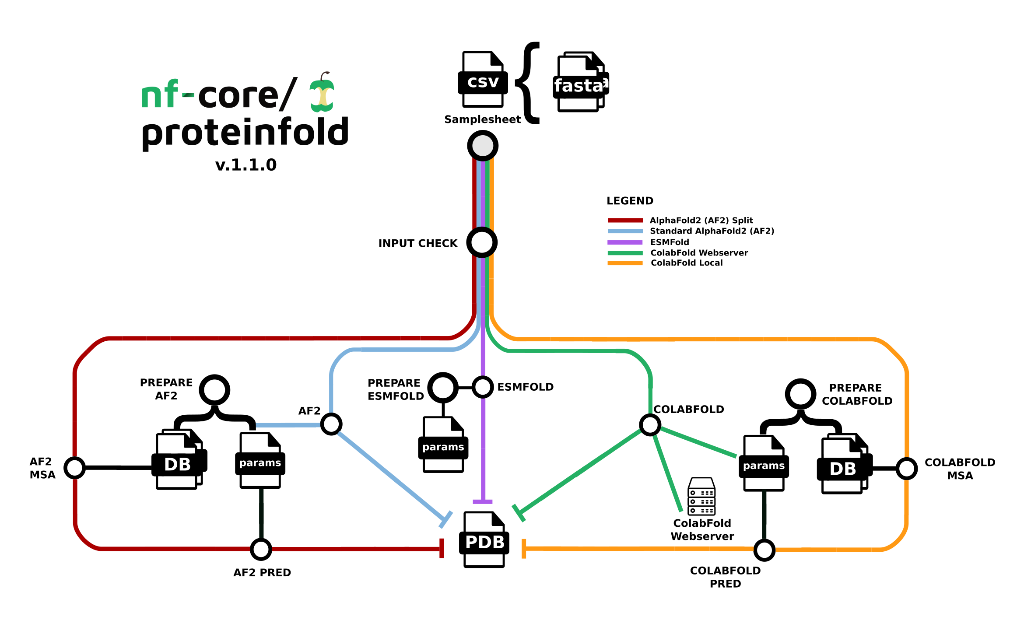
Developing ProteinFold Protein structure prediction from a spreadsheet (NextFlow)

Slide 3
Protein prediction structure Q&A at any time
How did we get here? – 15 mins
A quick history of protein structure folding – how did we get to AlphaFold?
Looking under the hood – roughly how does AlphaFold work
Software access – 10 mins
Code choice – Different accuracies & speeds
Licenses – restrictions to non-commercial use, and restriction-free software
Pipelines automating research – 15 mins
Research pipeline – different expertise pipelines between facilities
Providing easy access – using Open Source code and a web form
Live demo – 15 mins
Medical proteins – example class of fatty-acid binding proteins predicted by AlphaFold
ProteinFold – AlphaFold & co. through a sample spreadsheet
On-Demand ProteinFold – automated webform to a university cluster
Do it yourself – remaining time
Running AlphaFold2 in a Google Colab notebook
Notes:
Update with new content, including UNSW pipelines

Slide 4

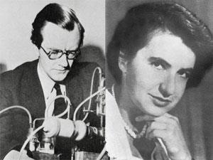
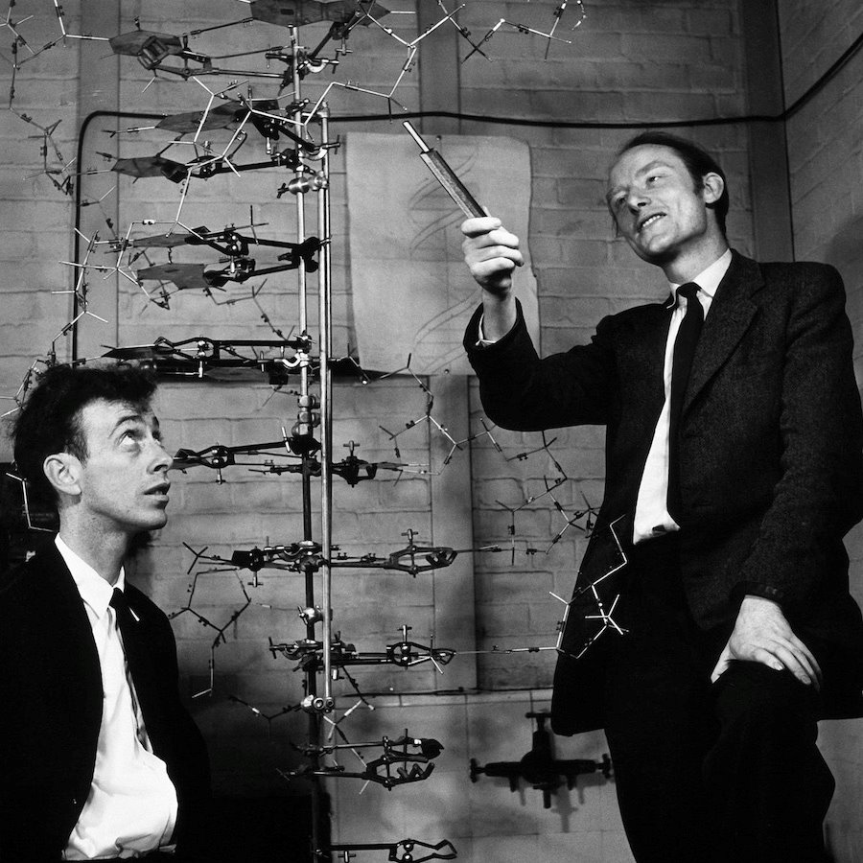
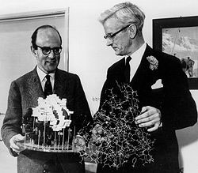
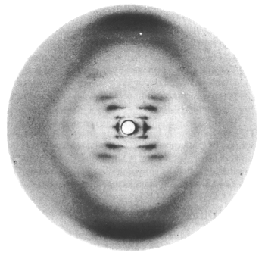
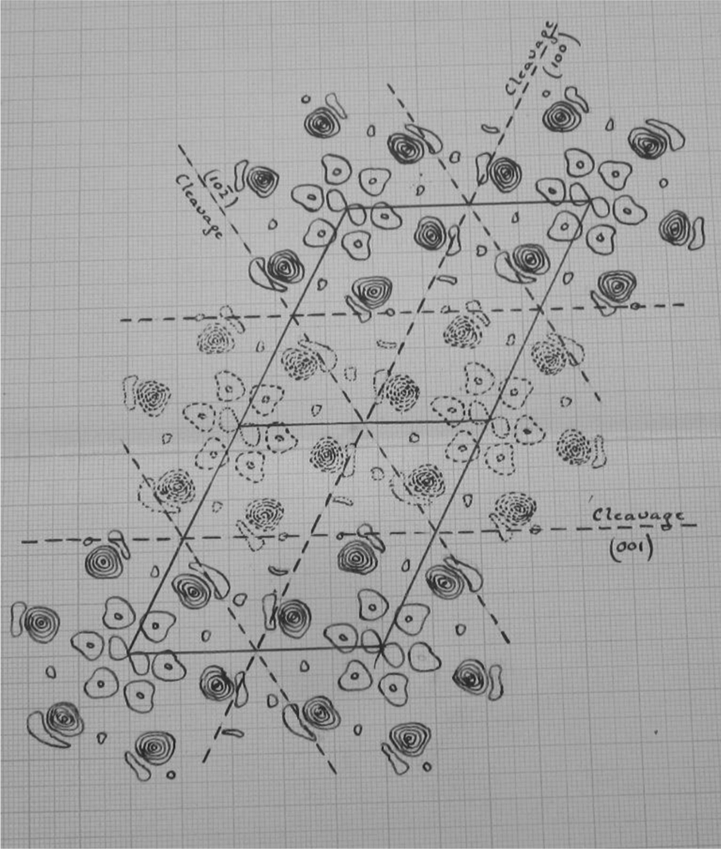
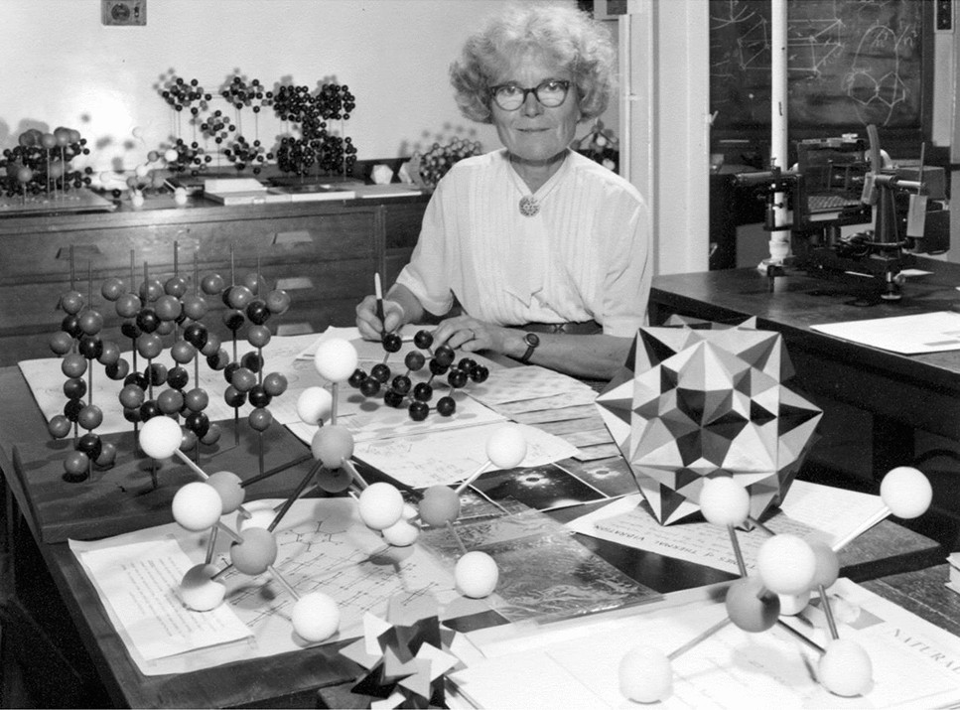
Models in Chemical Biology - function follows chemical form
Schrödinger speculates on
the molecules of life 1944
Perutz & Kendrew's model of the 3D structure of a protein (myoglobin) 1957 ​
Watson & Crick's DNA double-helix model 1953
Wilkins & Fraklin's X-ray diffraction images of DNA 1953
Kathleen Lonsdale resolves the structure of benzene 1924

Slide 5
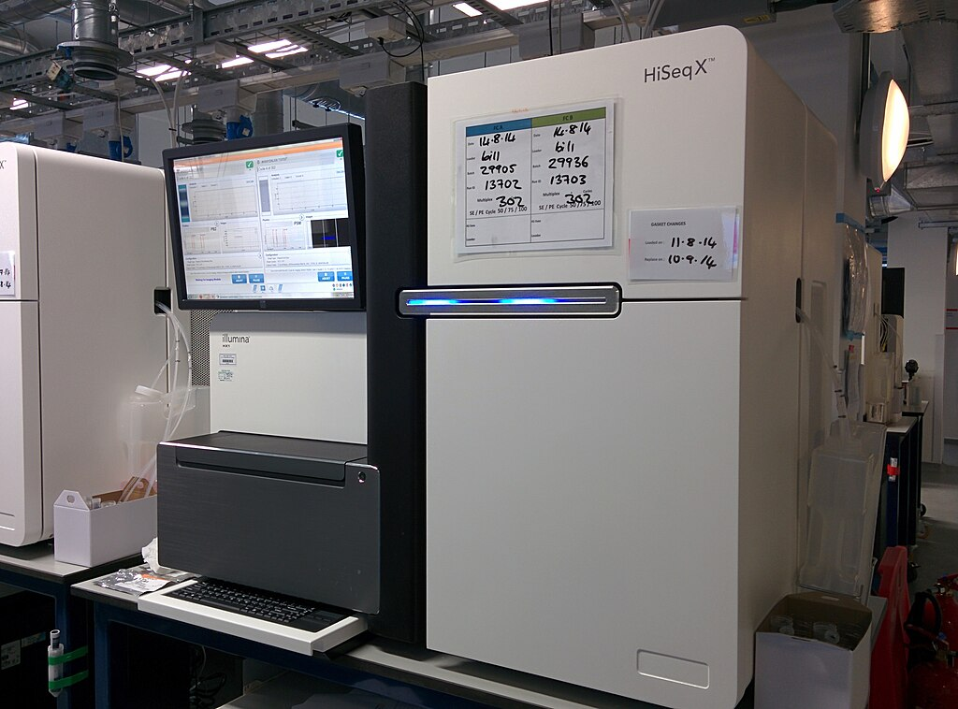
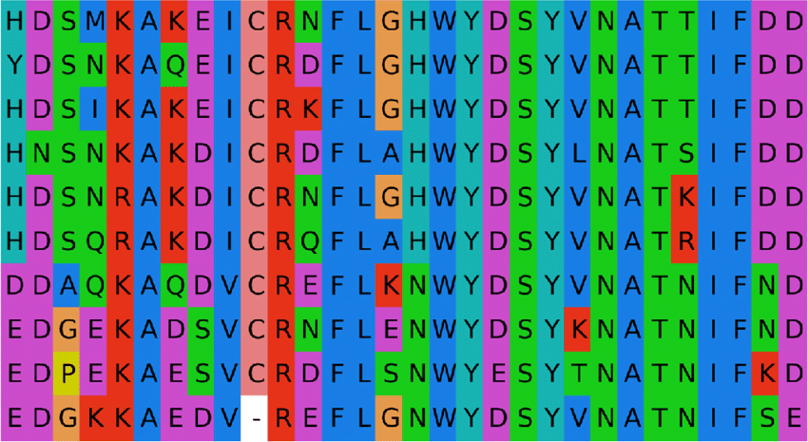
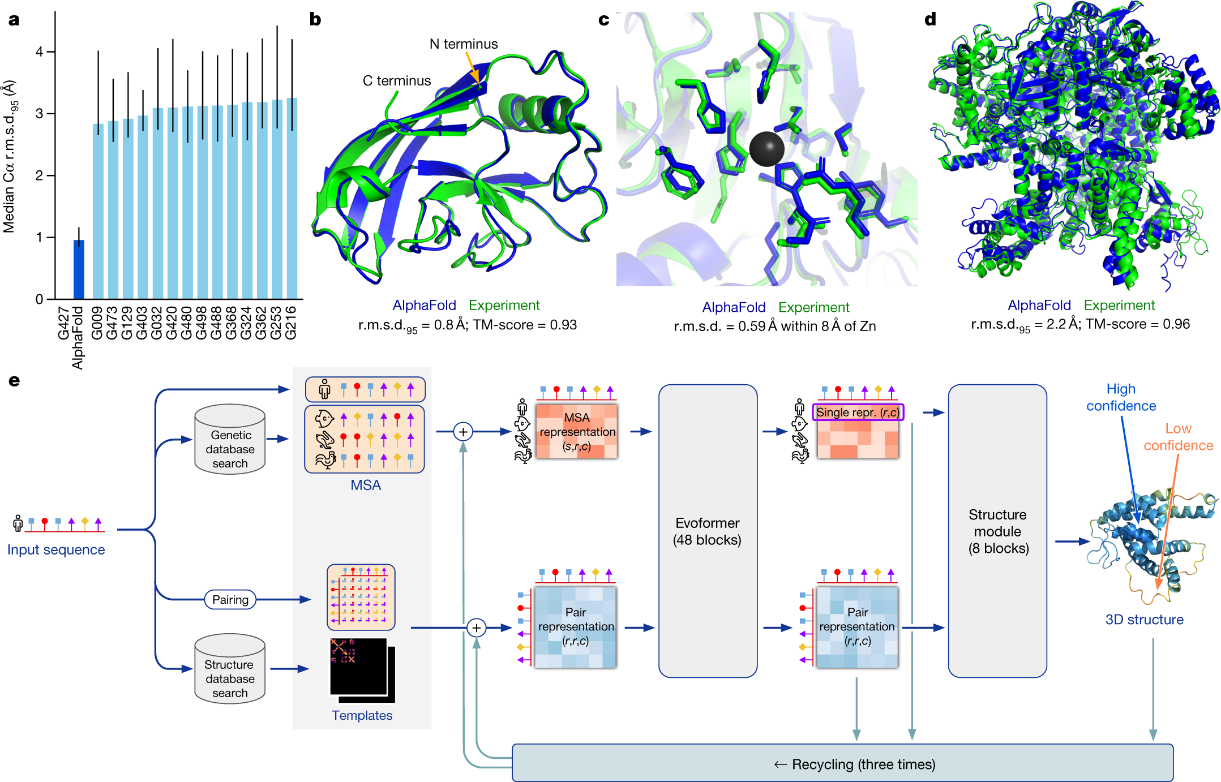
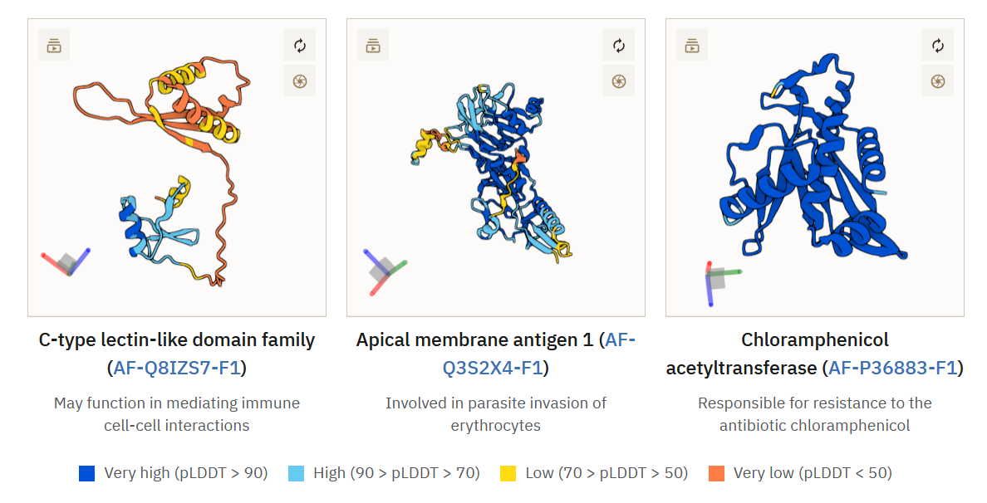
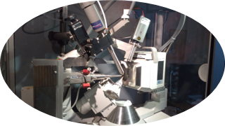
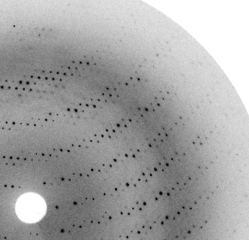
Deep Learning trained on experimental data
From genetic sequence
To modelled structure prediction
via computer
From protein
structure
Source: https://www.ebi.ac.uk/training/online/courses/alphafold/inputs-and-outputs/evaluating-alphafolds-predicted-structures-using-confidence-scores/plddt-understanding-local-confidence/

Slide 6
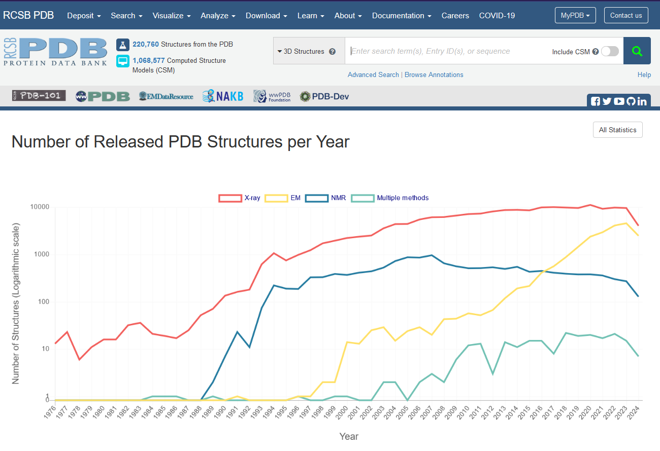
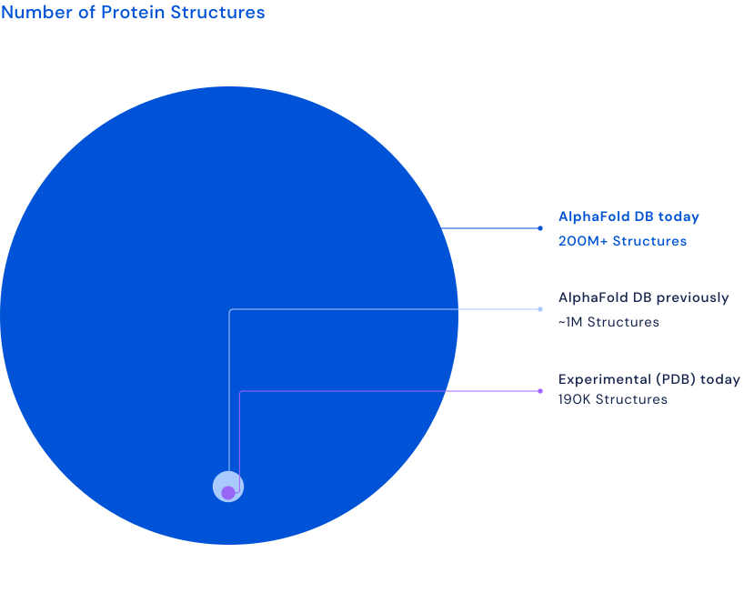
X-rays ruled 20thC – CryoEM & Calcs the 21st
Protein Data Bank (PDB)
Compute power – Moore's law + DNA Sequencing – super-Moore's law +
Deep Learning – context scaling laws
=
Comp.Struct.Bio. - 1000x in 2 years

Slide 7
AlphaFold2 A leap forward in computational prediction accuracy
Fig. 1: AlphaFold produces highly accurate structures – from "Highly accurate protein structure prediction with AlphaFold" - Nature, 596, 583-89 (2021).
Improvements
More than 2x as accurate as anyone else​
The global fold reliable when compared to very expensive experiments​
Set the algorithm architecture that is that standard today​

Slide 8


Alpha'Fold' programs – the way they 'fold' is very strange
No (explicit) Physics or Chemistry
Large Language Models (e.g. GPT) learns context from pure text tokens EvoFormers learns 1D -> 2D -> 3D from sequence and solved structures in Protein Data Bank (PDB)
Supplementary Videos: Ahdritz, G., Bouatta, N., Floristean, C. et al. OpenFold: retraining AlphaFold2 yields new insights into its learning mechanisms and capacity for generalization. Nat Methods 21, 1514–1524 (2024). https://doi.org/10.1038/s41592-024-02272-z
PDB ID: 7RDT
PDB ID: 7B3A

Slide 9
AlphaFold2 Ingenious algorithm design made this breakthrough
Assemble the amino acid triangles
Spatial relationships
Slow..
Related species
GPU intensive
CPU
Genetic
Preserved across evolution
Related proteins Known residue contacts
Fig. 1: AlphaFold produces highly accurate structures – from "Highly accurate protein structure prediction with AlphaFold" - Nature, 596, 583-89 (2021). ​

Slide 10
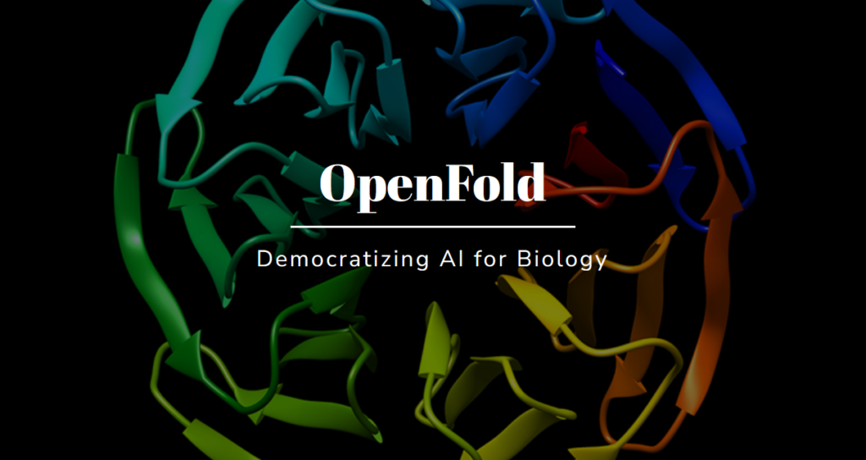








Alpha'Fold'-style software
The largest Big Tech and academic groups in world dedicated serious expertise & resources into developing these programs.
Please cite!
Code
Papers
Clusters
Facilities
They are mostly free and open source (academic, non-commercial work). If you develop the skills to run the code on local hardware.
github.com/google-deepmind/alphafold
github.com/google-deepmind/alphafold3
github.com/facebookresearch/esm
github.com/aqlaboratory/openfold
github.com/bytedance/Protenix
github.com/jwohlwend/boltz
github.com/sokrypton/ColabFold
github.com/baker-laboratory/RoseTTAFold-All-Atom
Notes:
Tech companies have dedicated, well-optimised web forms. We're going to talk the academic space "Be aware of licences, cite papers, cite software, be careful"

Slide 11
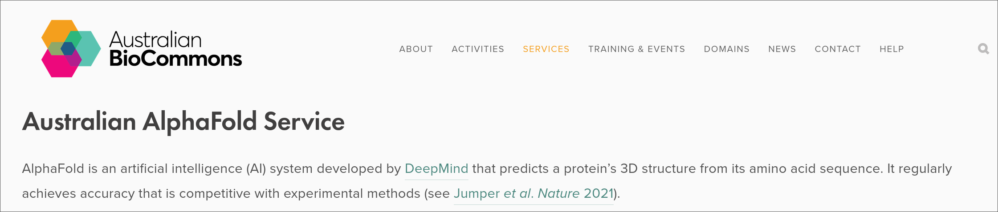
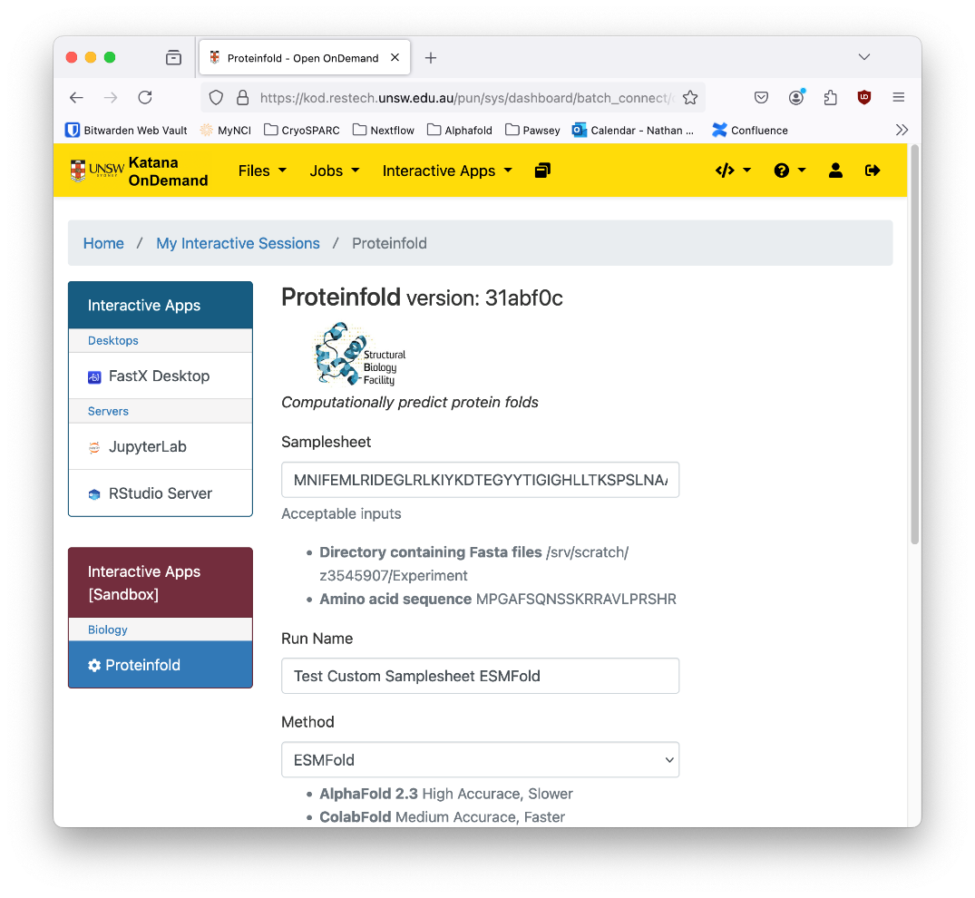

Where to run?
Galaxy Aus
All open code!
AlphaFold2: (Google Deepmind) github.com/google-deepmind/alphafold
Galaxy: (Cam Hyde, Grace Hall)
github.com/usegalaxy-au/tools-au/tree/master/
tools/alphafold
Aus Service: (Aus BioCommons)
biocommons.org.au/ alphafold
ProteinFold:
(nf-core, CGR, SBF) nf-co.re/proteinfold
OnDemand Web Form:
(SBF devs)
github.com/Australian-Structural-Biology-Computing/ood-proteinfold
Uni
proteinfold

Slide 12
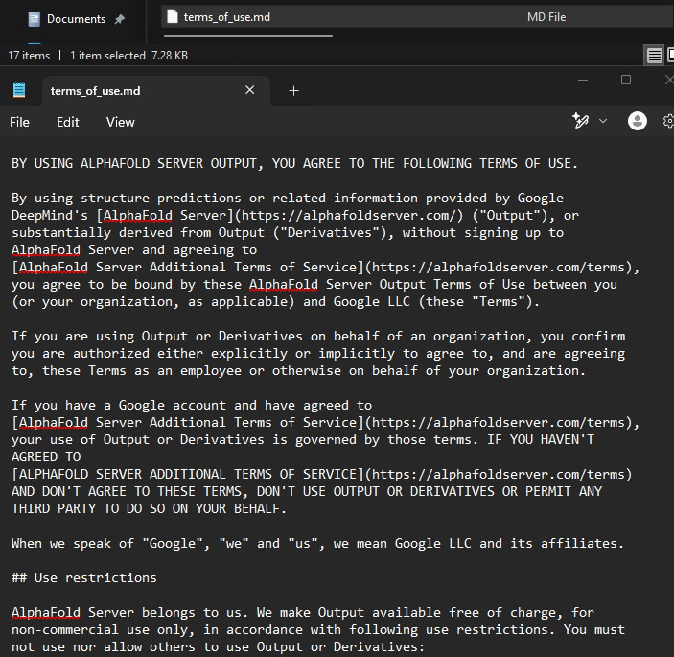
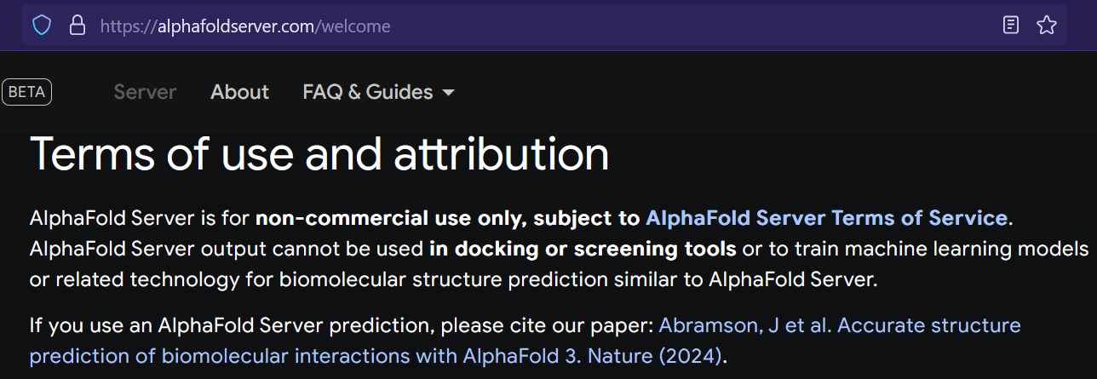
Licensing restrictions Think before you input!

Slide 13
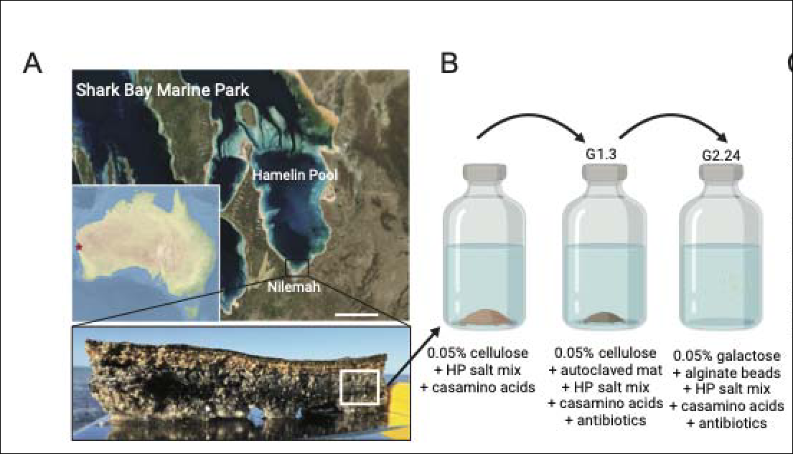
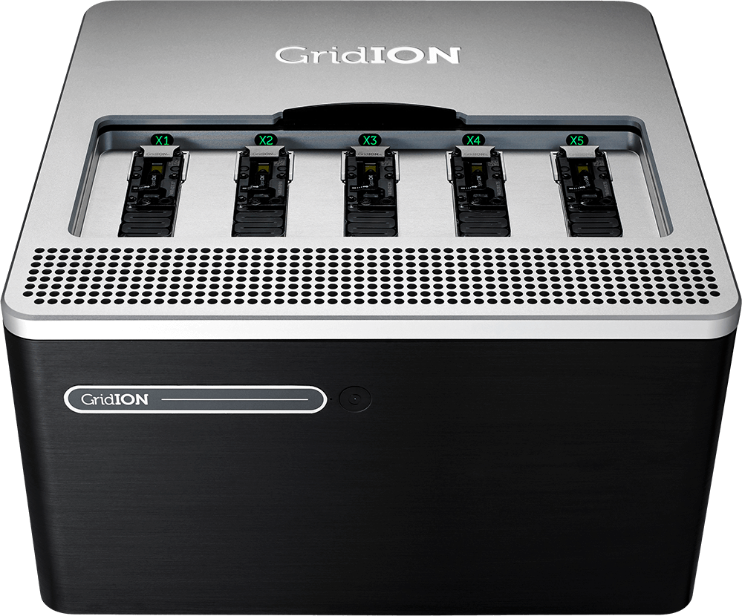


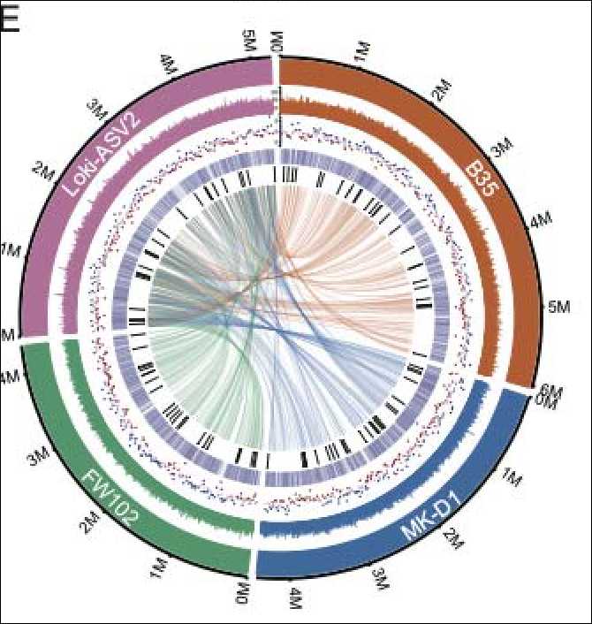

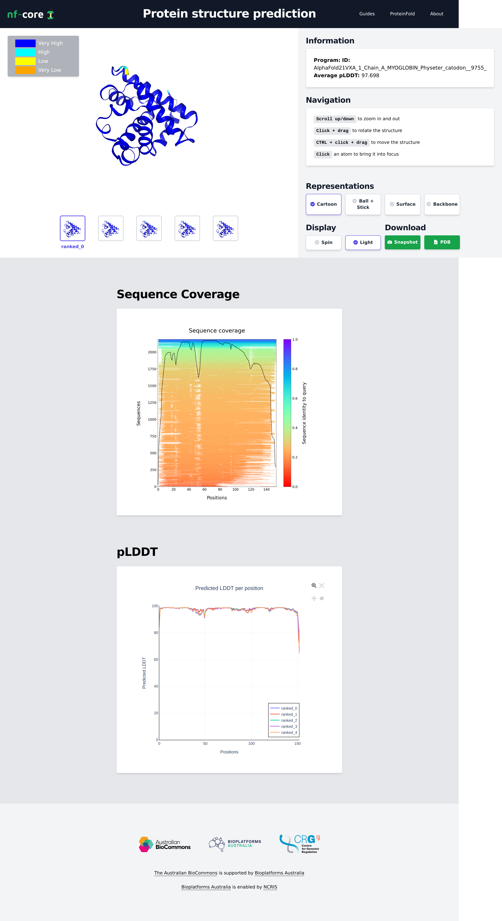
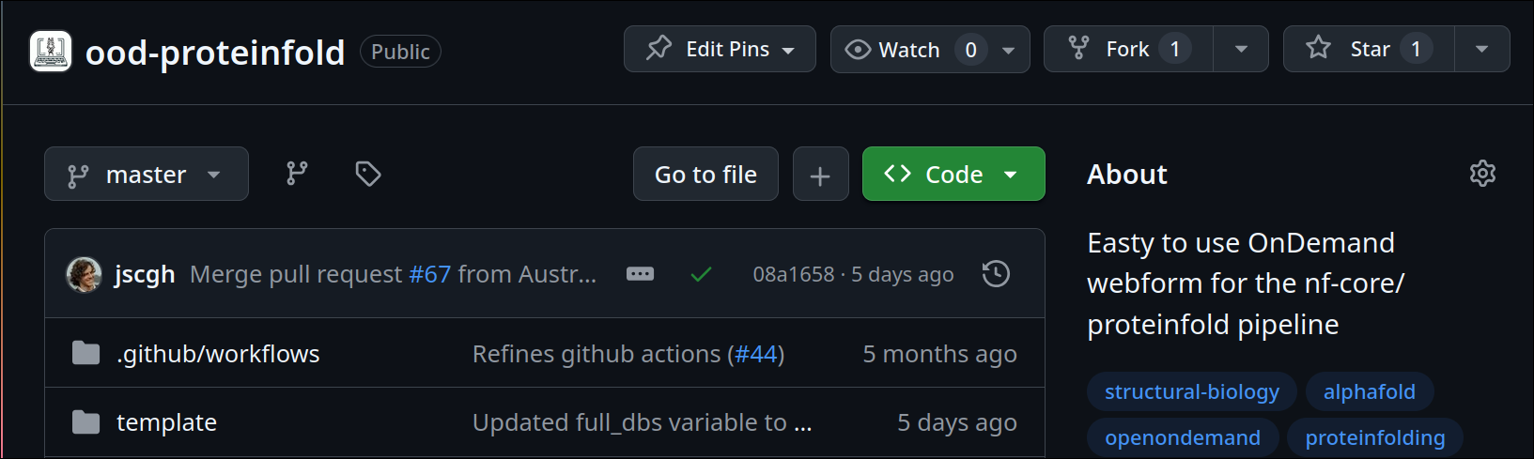
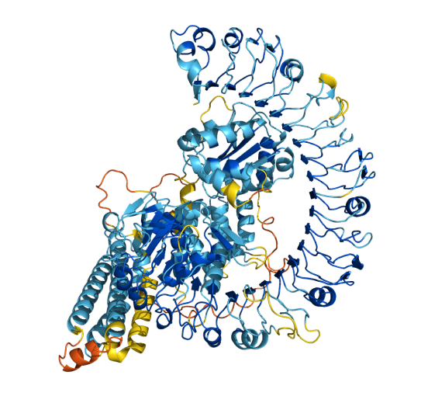
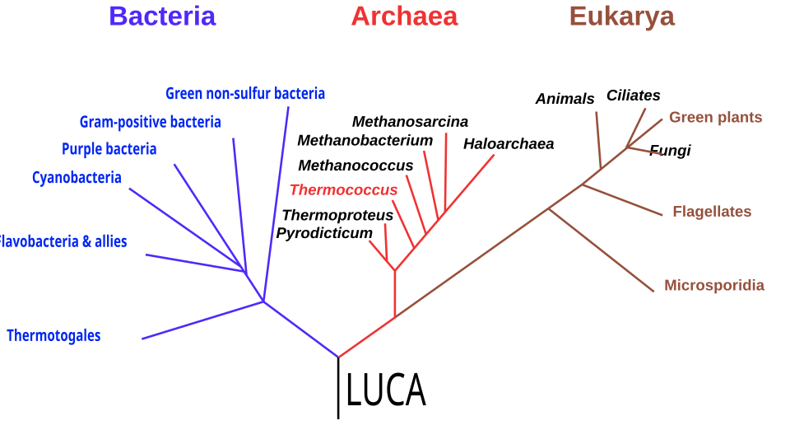

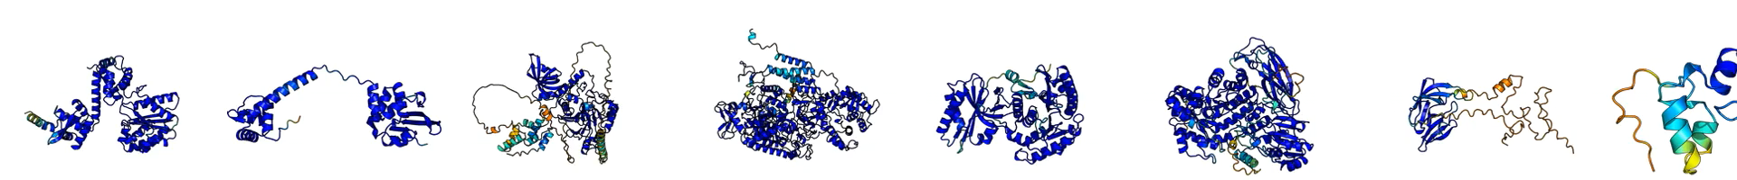
Folding Entire Proteomes
A pipeline of experts
An Asgard archaeon from a modern analog of ancient microbial mats: Nobs; S., Johnson; M. D., Williams; T. J., Meltzer; J., Vázquez-Campos; X., MacLeod; F. I., Rowell; K., Pitt; M., Paul; B., Shepherd; D. C., Michie; K. A., Duggin; I., G. Ghosal; D., Burns; B. P.
Predicted Proteome: github.com/keiran-rowell-unsw/Loki-ASV2_in_silico
Genome Sequencing
Genome Bioinformatics
HPC
Oxford Nanopore Technologies Gridion
Culturing
4544 proteins
Sampling
Reports
Struct. Pred.
Struct. Search
Struct. Bio. Analysis
Software Dev.
Notes:
Discussion w/ Xabi Go back to the paper
Just say there are experts along each part.
Sampling: Fraser/Stef (Xabi doesn't know) -- 2019 when it happened. Culturing: Fraser/Stef/Julia - Culturing enrichments since 2019
Could do at Ramciotti but UTS offered (free) "mates rates".
Transfer every 3-6 months over and over.
Sequencing: Miranda @UTS, Xabi used standard shotgun data (more complicated than that). DNA extract was not long read
Genome bioinformatics: Xabi – assembly was not circular straight away, isolate "subgraph assembly" (look up), more stringent with QC. Do a single reassambly (many times) until getting an actual circular closed genome assembly. Re-orientation of the genome (easier to do comparative genomics in start in the same index). Polish with available shortread data (couple of programs). Genome level annotation – DFast (+ other tools). Pathway ANVIO mapping tool. -> closed genome.fasta to Keiran. [No amazingly good way to validate ORFs unless you have full RNA-seq. Prokayorate has 90+% prediction percent).
Folding protein: SBF comp team – Keiran/Nathan(sample sheet utils)/Josh (error maintence).
Protein structure importance analysis: Kate/Stef

Slide 14
Example set: Fatty acid-binding proteins (FABPs, blood-brain barrier transport)
# | Gene | Tissue | UniProt (sequence) | Protein Data Bank (crystal) | AlphaFoldDB (calculation)
1 | FABP1 | Liver | P07148 | 2F73 | AF-P07148-F1
2 | FABP2 | Intestine | P12104 | 3AKM | AF-P12104-F1
3 | FABP3 | Muscle (Heart) | P05413 | 1G5W | AF-P05413-F1
4 | FABP4 | Adipose | P15090 | 1TOU | AF-P15090-F1
5 | FABP5 | Epidermal | Q01469 | 1B56 | AF-Q01469-F1
6 | FABP6 | Small intestine | P51161 | 5L8I | AF-P51161-F1
7 | FABP7 | Brain | O15540 | 1FDQ | AF-O15540-F1
8 | PMP2 | PNS | P02689 | 2WUT | AF-P02689-F1
9 | FABP9 | - | Q0Z7S8 | 4A60 | AF-Q0Z7S8-F1
- | - | - | - | - | -
11 | → FAB3 | Fish (?) | - | - | -
12 | FABP12 | Retina | A6NFH5 | - | AF-A6NFH5-F1
Source: Wikipedia & Scientific databases – Fatty acid binding protein – family members
Notes:
Discussion w/ Xabi Go back to the paper
Just say there are experts along each part.
Sampling: Fraser/Stef (Xabi doesn't know) -- 2019 when it happened. Culturing: Fraser/Stef/Julia - Culturing enrichments since 2019
Could do at Ramciotti but UTS offered (free) "mates rates".
Transfer every 3-6 months over and over.
Sequencing: Miranda @UTS, Xabi used standard shotgun data (more complicated than that). DNA extract was not long read
Genome bioinformatics: Xabi – assembly was not circular straight away, isolate "subgraph assembly" (look up), more stringent with QC. Do a single reassambly (many times) until getting an actual circular closed genome assembly. Re-orientation of the genome (easier to do comparative genomics in start in the same index). Polish with available shortread data (couple of programs). Genome level annotation – DFast (+ other tools). Pathway ANVIO mapping tool. -> closed genome.fasta to Keiran. [No amazingly good way to validate ORFs unless you have full RNA-seq. Prokayorate has 90+% prediction percent).
Folding protein: SBF comp team – Keiran/Nathan(sample sheet utils)/Josh (error maintence).
Protein structure importance analysis: Kate/Stef

Slide 15
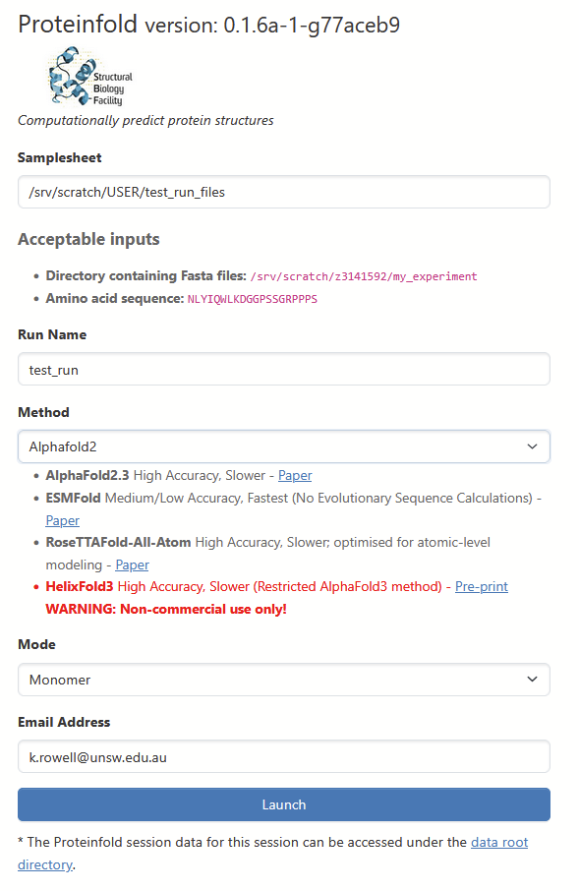
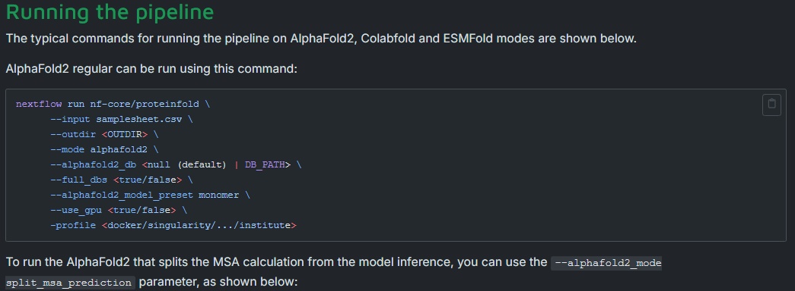
Live Demo – ProteinFold terminal vs Web

Slide 16
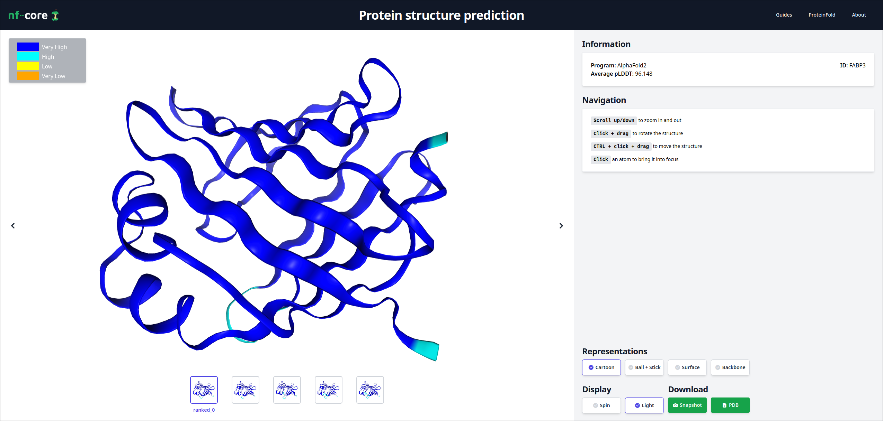
Report – the structure

Slide 17
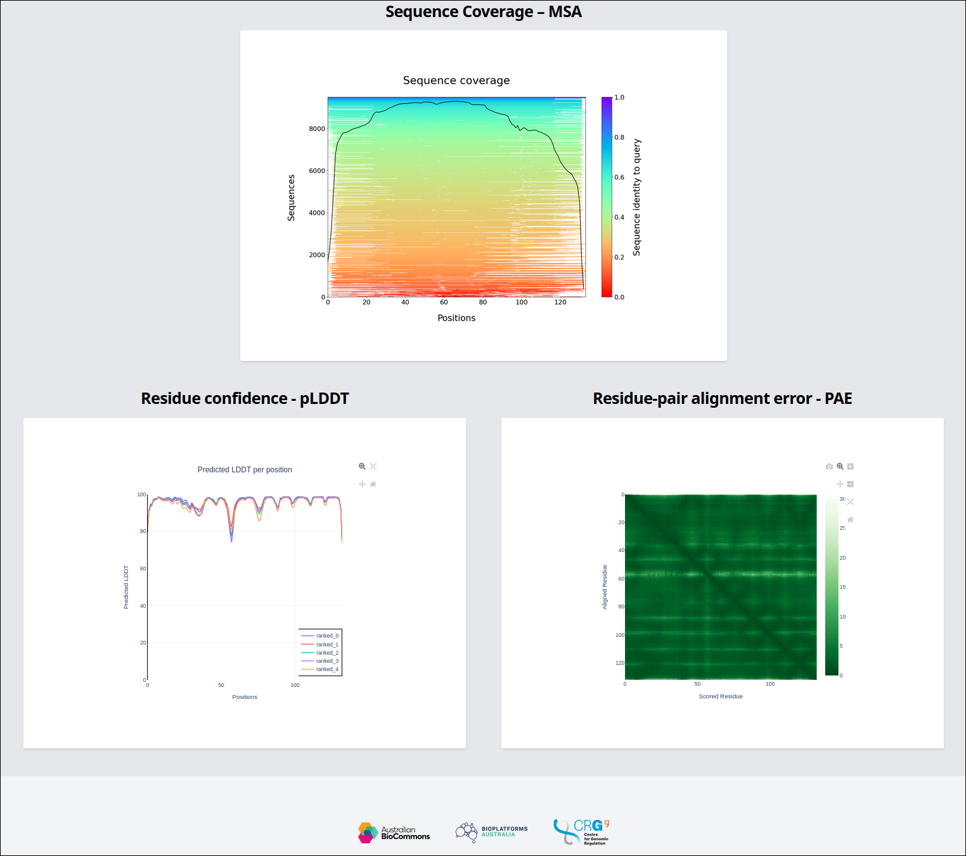
Report – the metrics

Slide 18
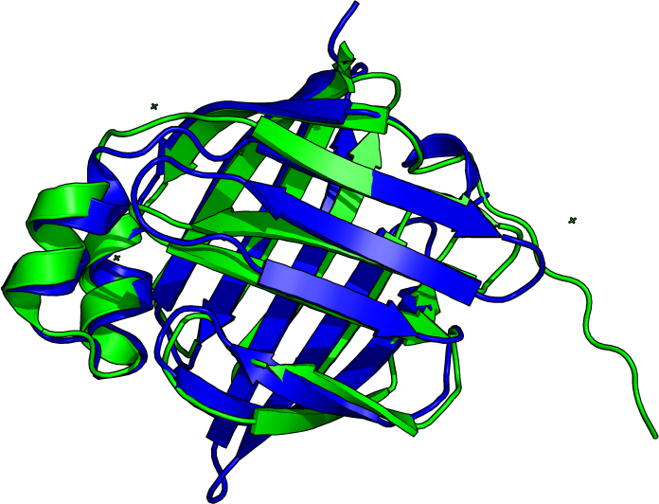
Comparison – prediction vs crystallised
AlphaFold
Experiment

Slide 19
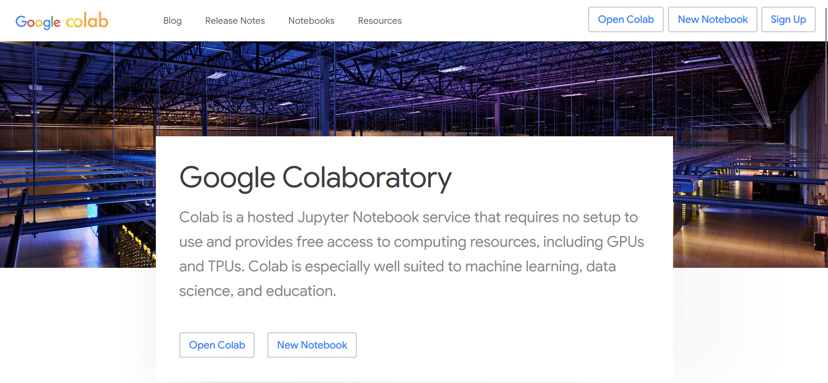
ColabFold – running AlphaFold2 on Colab
unsw.to/colabfold

Slide 20
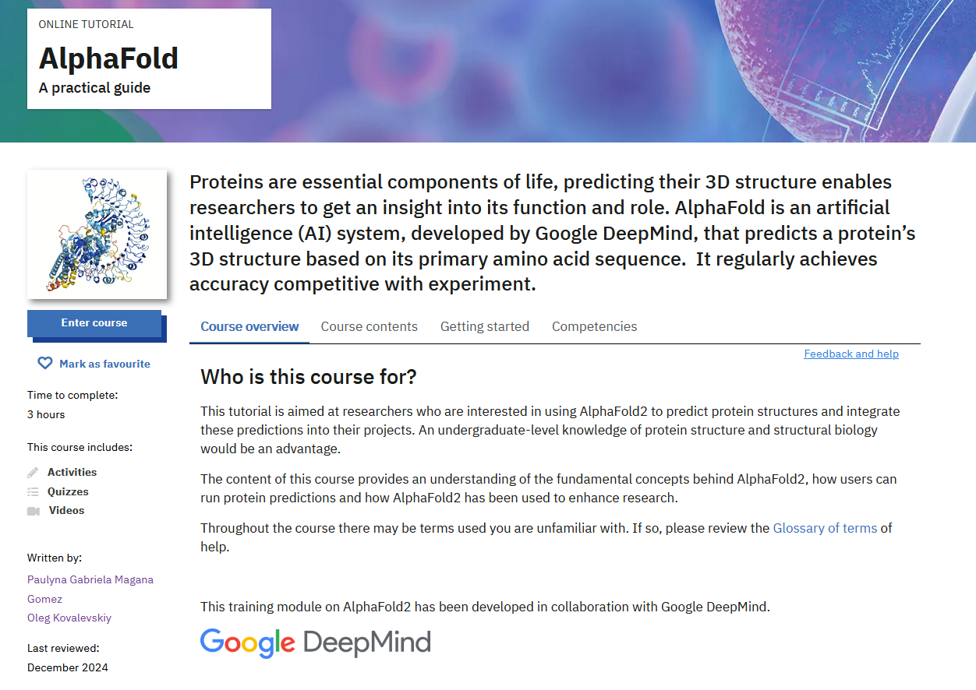
Self-learning – spend 3 hrs with the pros!
https://www.ebi.ac.uk/training/online/courses/alphafold/

